Slide 1

Opening a New Supermarket in Amsterdam, the Netherlands
IBM – Professional data science program
Capstone – Final project
By Ali Soleymani
March 2020

Slide 2
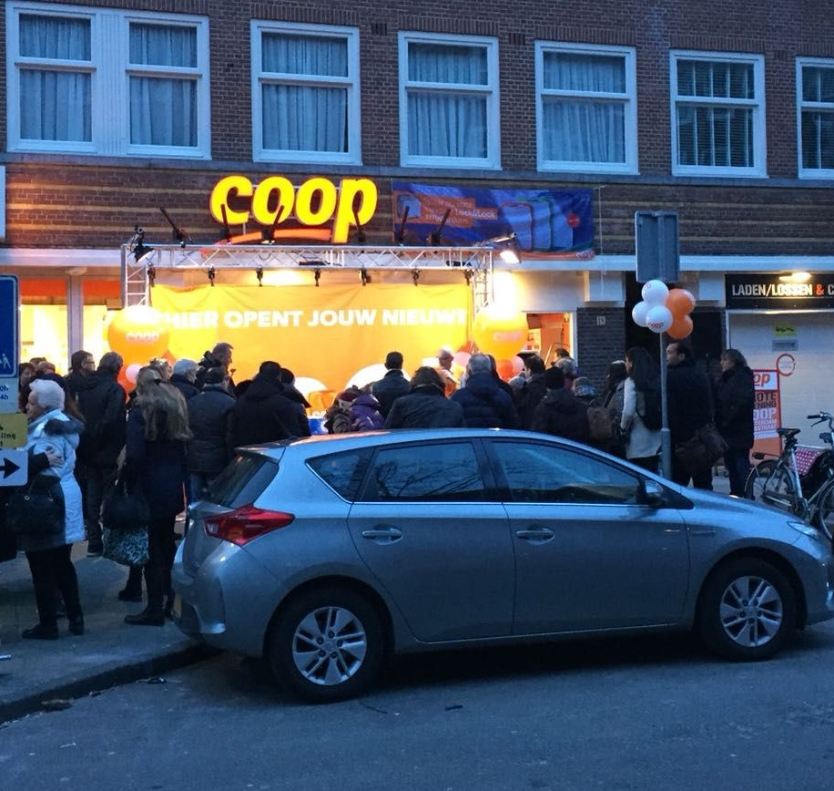
Introduction
Having access to the supermarkets can be a key feature for choosing the right place to live.
It can be very important for policy makers, city municipality and investors to understand the people’s needs.

Slide 3

Problem
In the city of Amsterdam, if an investor is looking for opening a new supermarket, where would you recommend that they open it?
And, if someone is looking for a suitable place to live with a good access to supermarket where would be the best place?

Slide 4

Data
List of neighborhoods in Amsterdam.
Latitude and longitude coordinates of those neighborhoods. This is required to plot the map and to get the venue data.
Venue data, particularly data related to the supermarkets. We will use this data to perform clustering on the neighborhoods.

Slide 5




Source of data and extracting methods
Wikipedia page
Python requests and beautifulsoup packages
Python Geocoder package
Foursquare API
machine learning (K-means clustering)

Slide 6
Methodology
list of neighborhood from the following Wikipedia page(https://en.wikipedia.org/wiki/Category:Neighbourhoods_of_Amsterdam).
using Python requests and beautifulsoup packages
Geocoder package to convert address into geographical coordinates
visualize using Folium package on a map
Foursquare API
clustering on the data by using k-means

Slide 7
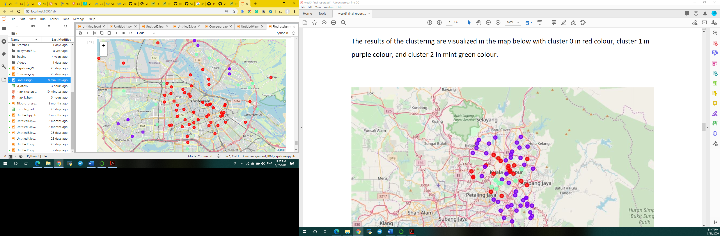
Results
• Cluster 0: Area with moderate number of supermarkets - Red
• Cluster 1: Area with low number to no existence of supermarkets - Purple
• Cluster 2: Area with high concentration of supermarkets – Mint green

Slide 8

Discussion
Most of the supermarkets are concentrated in the central area of Amsterdam, with the highest number in cluster 2 and moderate number in cluster 0. On the other hand, cluster 1 has very low number to no supermarket in the area. This represents a great opportunity and high potential areas to open new supermarket as there is very little to no competition from existing supermarkets.

